Slide 1

REST WEB SERVICES

Slide 2
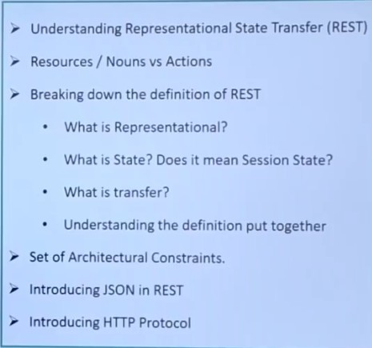

Slide 3
INTRODUCTION
Representational State Transfer.
Introduced by Roy Fielding in 2000 .
Architectural style (technically not a standard ) .
Uses existing standards, e.g. HTTP.
REST is an architecture all about the Client-Server communication.
REST is about how to manipulate resources .
3

Slide 4
REST
Client requests a specific Resource from the server.
The server responds to that request by delivering the requested resource .
Server does not have any information about any client
So there is no difference between the two request of the same client
<number>

Slide 5
RESOURCE
Rest server provides access to and rest client accessors and resources
Here is resource is identified by your URI / global IDs
rest uses various representations to represent a resource like XML,text ,JSON and etc

Slide 6
URI-Example
http : // local host : 9999 / rest api / books / {i d }
GET – get the book whose id is provided
POST – update the book whose id is provided
DELETE – delete the book whose id is provided
6

Slide 7
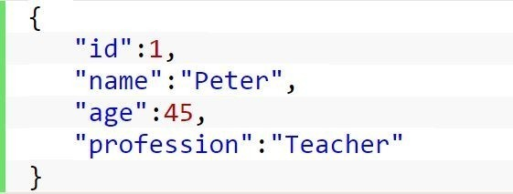
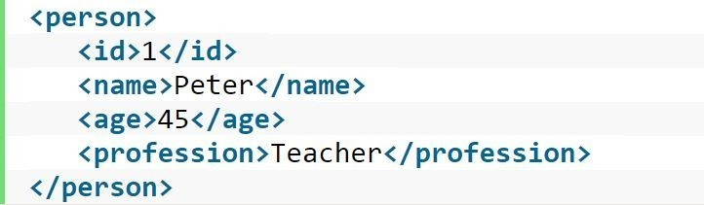
Resource Representation
<number>

Slide 8
R E Q U E S T S & R E S P O N S E S
RESTful web services uses HTTP protocol the medium to help the communication between client and server.
Client sends HTTP Request .
Server responds it by sending a HTTP Response .
This is called as messaging as well .
<number>

Slide 9
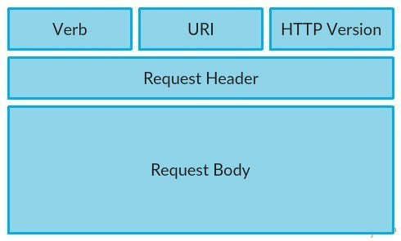
HTTP Request
<number>

Slide 10
HTTP Request Cont.
Verb- I n d i c a t e HTTP m e t h o d s s u c h as GET, POST, DELETE, PUT e t c .
URI- Uniform Resource Identifier to identify the resource on server .
HTTP Version - Indicate HTTP version .
Request Header - Contains met a data for the HTTP Request message as
key - value pairs .
Request Body – Message content or Resource representation .
<number>

Slide 11
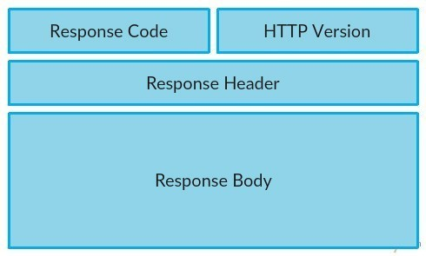
HTTP R e s p o n s e
<number>

Slide 12
HTTP R es pon se Cont.
S t a t u s / R e s p o n s e Code- Indicate Server s t a t u s for t h e requested resource .
HTTP Version- Indicate HTTP v e r s i o n , for e x a m p l e HTTP v1 .1.
R e s p o n s e Header- Contains m e t a d a t a for t he HTTP Response message as key - value pairs. For example, content l e n g t h , content t y p e , r e s p o n s e d a t e , s e r ve r t y p e etc.
R e s p o n s e Bo dy - R e s p o n s e m e s s a g e co ntent or

Slide 13
Addressing
Addressing refers to locati ng a r e s o ur c e s o n t h e s e r ve r .
It i s analogous to locate a postal address o f a person .
Each resource in REST architecture i s identified reso urce or b y its URI
< p r o t o c o l > : / / < s e r v i c e -
n a m e > /< R e s o u rce Ty p e > / < R e s o u rce ID>
.
13

Slide 14
Method
s | METHOD URI DESCRIPTION
 | GET (Read) | http://localhost:8080/UserManag ement/rest/UserService/users http://localhost:8080/UserManag ement/rest/UserService/users/1 | Get list of users. Get user of id=1.
 | POST (Create/ Update) | http://localhost:8080/UserManag ement/rest/UserService/users/2 | Update user where user id=2.
 | PUT (Update ) | http://localhost:8080/UserManag ement/rest/UserService/users/2 | Insert user with id=2.
<number>

Slide 15
Methods Cont.
Delete (Delete) | http://localhost:8080/UserManage ment/rest/UserService/users/1 | Delete user where user id=1.
Options | http://localhost:8080/UserManage ment/rest/UserService/users | List supported web service operations.
Head | http://localhost:8080/UserManage ment/rest/UserService/users | Returns HTTP header only.
Method
User Id
Description
<number>

Slide 16
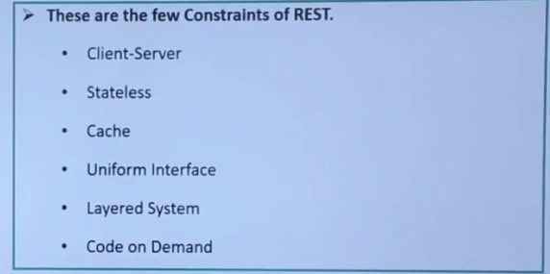

Slide 17
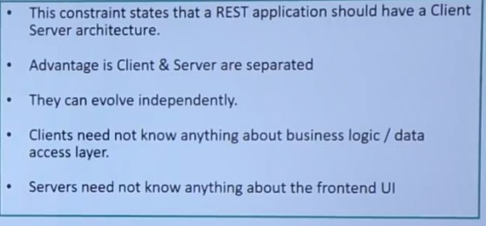
Client server Constraints

Slide 18
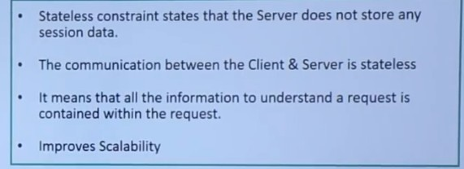
Stateless Constraints

Slide 19
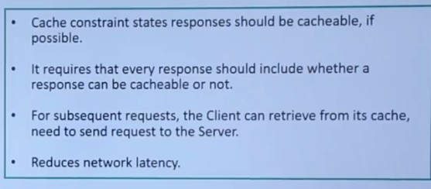
Cache Constraints

Slide 20
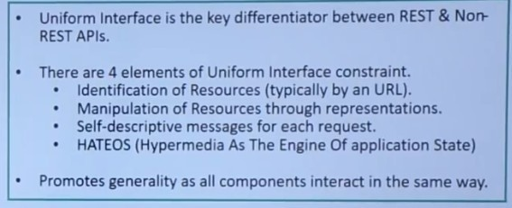
Uniform interface Constraints

Slide 21
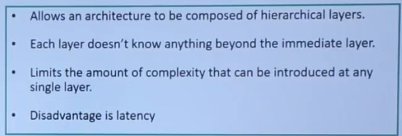
Layered arch Constraints

Slide 22
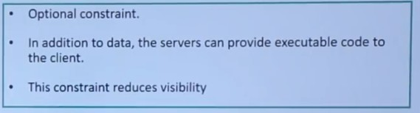
Code on demand Constraints

Slide 23
HATEOAS
Hypermedia As The Engine Of
Used to discover locations and operations.
Link relations are used to express options .
Clients do not need to know URLs.
This controls the state .
E.g : Where t h e u s e r i s , I n s t r u c t i o n s o n u s e r ’ s s t e p s .
<number>

Slide 24
HATEOAS Cont.
Links contain
The target ( href,mandatory) .
A short relationship indication ( rel,mandatory). ( e .g . “ details ” , “ payment ” , “ cancel ” ) .
The content type needed for the request (type, optional).
The HTTP method (method , optional)
•
<number>

Slide 25
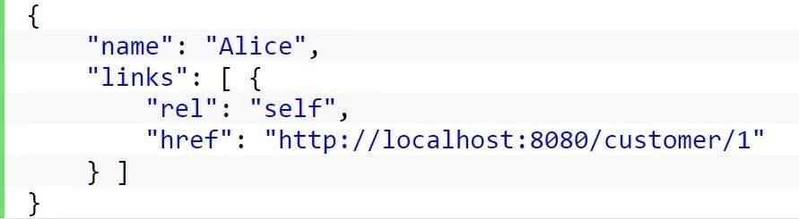
HATEOAS Cont.
Sample HATEOAS-based response
<number>

Slide 26
JAX-RS
JAX-RS s t a n d s
f o r JAVA API for RESTful Web S e r v i c e s .
JAX-RS is a JAVA based programming language API and specification to
Provide support for created RESTful Web se r v i c e s .
JAX-RS makes heavy use of annotations to simplify development of JAVA
Based web services.
<number>

Slide 27
Some JAX-RS Annotation s
Annotation | Description
@ Path | Relative path of the resource class/method.
@GET | Used to fetch resource.
@POST | Used to create/update resource.
@DELETE | Used to delete resource.
@HEAD | Used to get status of method availability.
@ PUT | Used to create resource.
<number>

Slide 28
Some JAX-RS Annotations
Annotation
Description
Binds the parameter passed to method to a value in path.
Binds the parameter passed to method to a query parameter in path.
Binds the parameter passed to method to a form value.
Binds the parameter passed to
@PathParam
@QueryParam
@FormParam
@CookieParam
method to a Cookie.
@HeaderParam Binds the parameter passed to
method to a HTTP header.
<number>

Slide 29
Implementations
Apache CXF, an open source Web service frame work .
Jersey, the reference implementation
From Sun (now Oracle).
RESTeasy, J Boss ' s implementation.
Restlet .
WebSphere Application S e r v e r from IBM.
<number>

Slide 30
Brie f
Code Description type
1XX | Informational
2XX | Success
3XX | Redirection
4XX | Client Error
5XX | Server Error
<number>

Slide 31
Status Codes in Brief
20 0 OK
The reque s t has succeeded .
201 Created
The request has succeeded and a new resource has been created as a result o f it.
3 0 1 Moved Permanently
URI of requeste d resource has been changed.
307 Temporary Redirect
Directing client to get requested resource to another URI.
<number>

Slide 32
Status Codes in Brief
308 Permanent Redirect
Resource is now permanently located at another URI.
400 Bad Request
Server could not understand the request due to invalid syntax .
403 Forbidden
Client does not have access rights to the content so server is rejecting
to give proper response .
<number>

Slide 33
Status Codes in Brief
404 Not Found
Server cannot find requested resource.
500 Internal Server Error
The s e r ve r has e n count ered a situation it doesn't know how to handle.
5 03 Service Unavailable
The server is not r eady to handle the request .
5 05 HTTP Version Not Supported
The HTTP v ersion used in the request is not supported by the server.
<number>

Slide 34
REST
It helps you organize even a very complex application into
simple resources .
Security: Use HTTPS.
Performance : REST is less CPU expensive.
Complexity: REST demands much less in terms of setup, it’s just GET/POST after all. SOAP requires much more
administrat ion to maintain.
<number>

Slide 35
REST v s SOAP
REST | SOAP
A style. | A standard.
Proper REST: Transport must be HTTP/HTTPS. | Normally transport is HTTP/ HTTPS but can be something else.
Response data is normally transmitted as XML, can be something else. | Response data is transmitted as XML.
Request is transmitted as URI. | Request is transmitted as XML.
<number>

Slide 36
REST v s SOAP
Cont.
REST SOAP
Easy to be called from JavaScript. | JavaScript can call SOAP but it is hard, and not very elegant.
If JSON is returned it is very powerful. | JavaScript parsing XML is slow and the methods differ from browser to browser.
Simply calls services via URL path. | Invokes services by calling RPC method.
result is readable with is just plain XML or JSON. | Doesn't return human readable result.
<number>

Slide 37
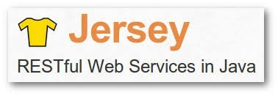

Slide 38
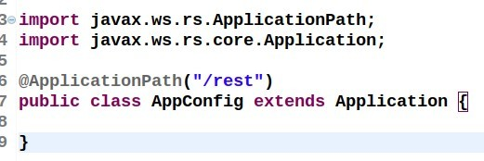
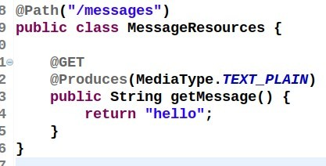

Slide 39
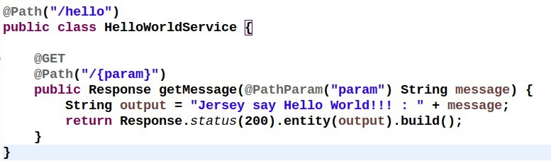
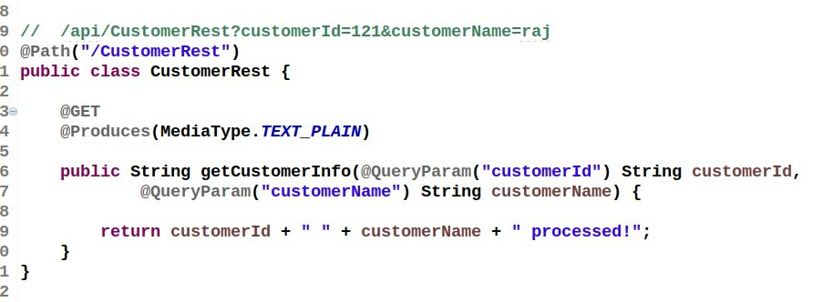

Slide 40
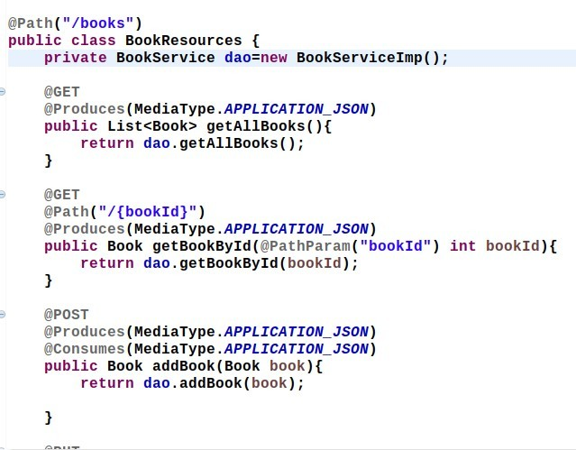

Slide 41
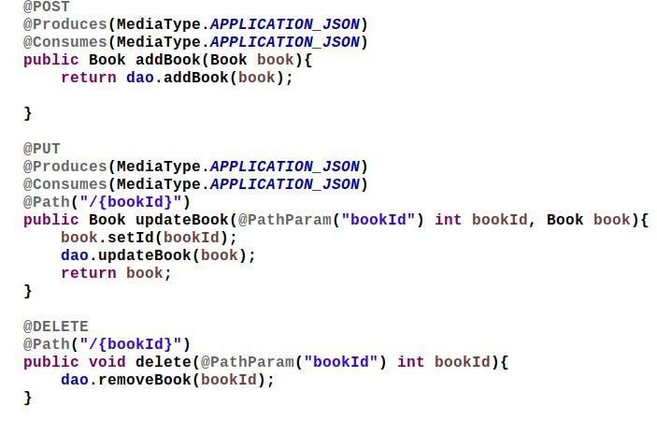

Slide 42
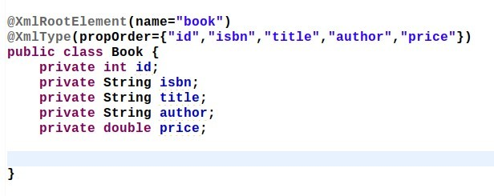

Slide 43
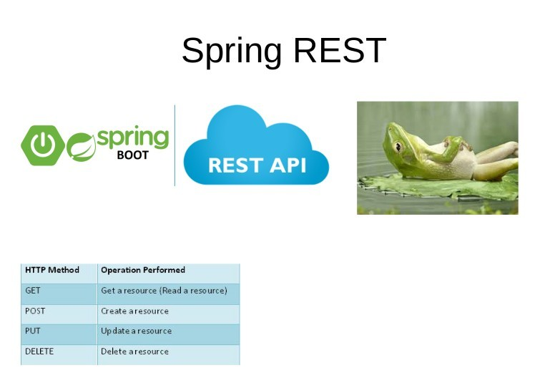

Slide 44
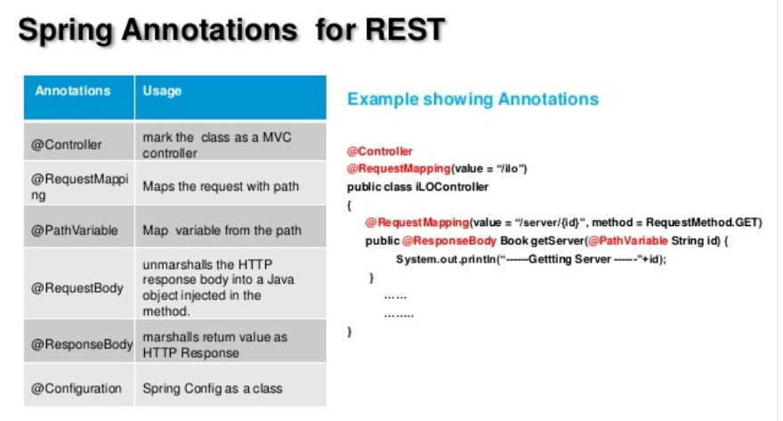

Slide 45
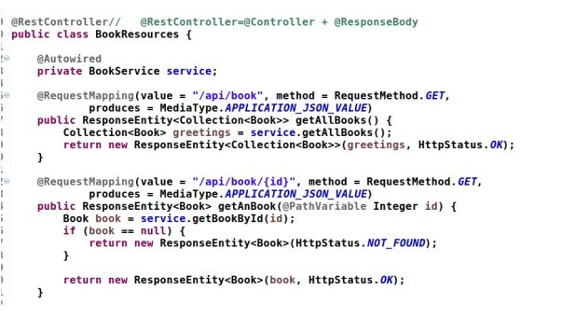

Slide 46
